Slide 1
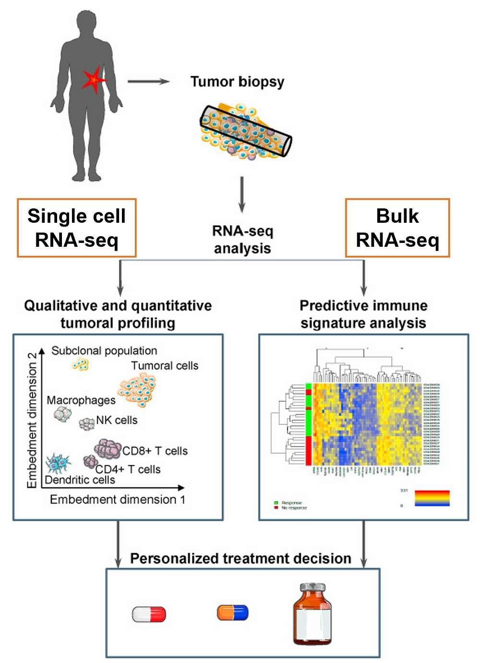
Clonal Evolution & Sequencing Technologies
Cancer evolves via sequential mutations, producing aggressive subclones.
Evolution is non-linear: multiple subclones can coexist or cooperate.
Sequencing advances: Bulk RNA-seq → Laser-capture → Single-cell → Spatial transcriptomics.
Methods: Bulk RNA-seq averages expression (good for homogeneous tissue); Single-cell isolates individual cells (good for complex tissue).

Slide 2
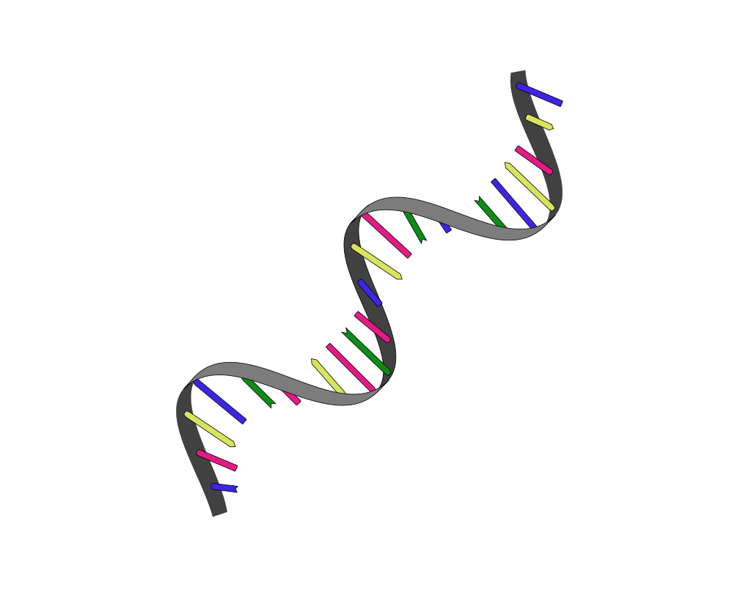
Tumour Heterogeneity & scRNA-seq Insights
Sources of Heterogeneity:
Genetic mutations
Epigenetic changes & stochastic expression
Tumour microenvironment (hypoxia, cytokines, stromal/immune cells)
scRNA-seq Capabilities:
Detects rare cells & dynamic states
Tracks developmental trajectories, EMT, drug tolerance
Maps cellular organization with spatial transcriptomics

Slide 3
Tracking cancer evolution
scRNA-seq for Evolution:
Profiles thousands of cells → identifies stem-like & drug-resistant subclones
Reconstructs transcriptional trajectories and subclonal phylogenies
Tools & Methods:
Copy-number alteration detection, somatic/mitochondrial mutation analysis
Computational: inferCNV, CopyKAT, SCEVAN
Experimental: CRISPR lineage tracing
Integration: Single-cell DNA/ATAC-seq + spatial data links genotype → phenotype → microenvironment

Slide 4
Therapy resistance
Heterogeneity drives variable drug response
Beyondcell: maps therapeutic clusters in single-cell data
scRNA-seq enables anticipation of resistant clones and improved treatment strategies

Slide 5
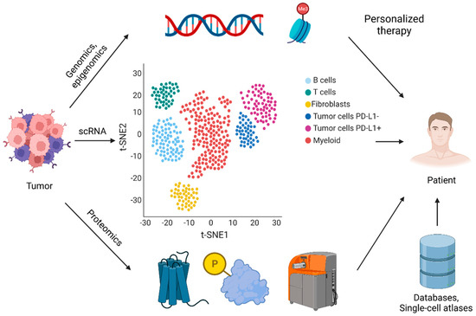
Challenges and future directions
Challenges of scRNA-seq:
Sample dissociation → stress & technical noise
Fresh tissue requirements → limits longitudinal studies
Organoids/cell lines → incomplete microenvironment replication
Future Directions:
Optimize fixation & storage
Integrate multi-omic single-cell analyses
Guide precision oncology interventions
10.3390/cancers14030657

